Slide 1
Dark Web Monitoring: Everything you need to know

Slide 2

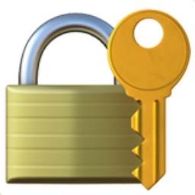





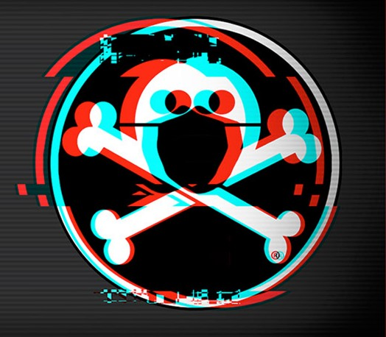



$whoami
Apurv Singh Gautam (@ASG_Sc0rpi0n)
Threat Researcher @
Cybersecurity @ Georgia Tech (Go Jackets)
Presented at conferences
Hobbies
Hiking
Lockpicking
Gaming/Streaming
Social
Twitter - @ASG_Sc0rpi0n
Website - apurvsinghgautam.me

Slide 3

Agenda
Introduction to the Dark Web
Why focusing on the Dark Web?
Methodology and Skills
People Skills
Technology Skills
OpSec? What’s that?
Case Study
Conclusion
Notes:
People skills
Technology Skills

Slide 4
1. Introduction to the Dark Web

Slide 5
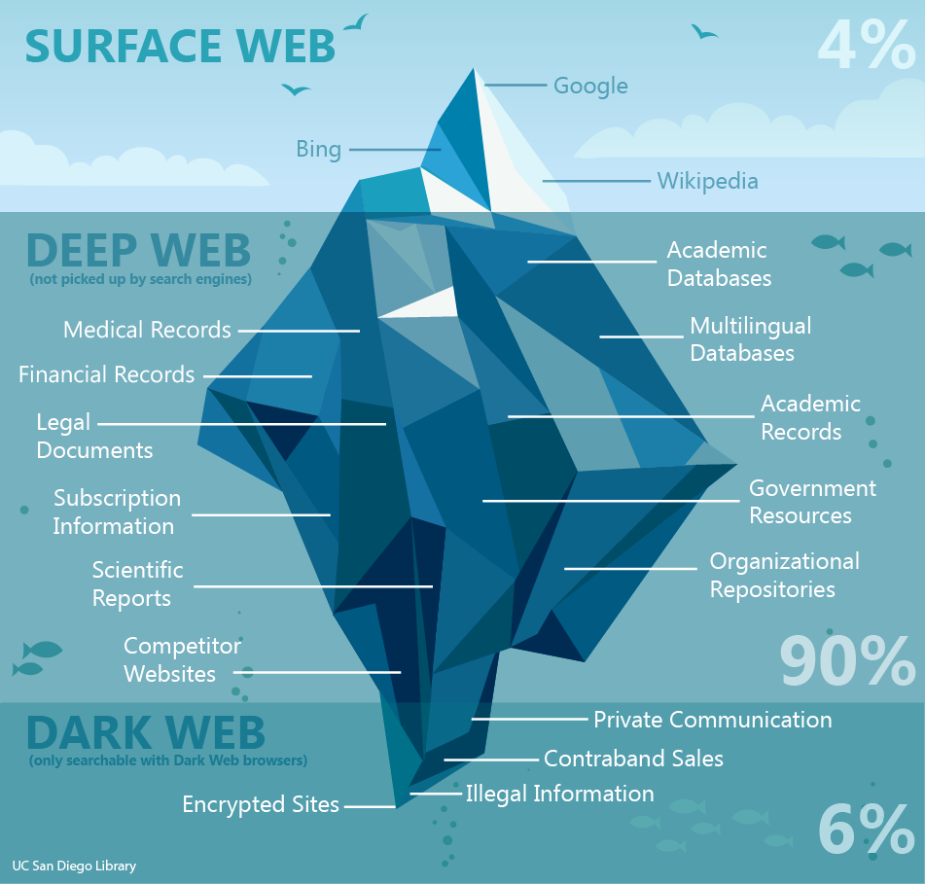
Clear Web? Deep Web? Dark Web?
Image Source: UC San Diego Library
Notes:
Clear web: Sites that are indexed by search engines
Deep web: Sites that are not indexed by search engines
Dark web: Sites that require special software, configuration or authorization to access

Slide 6



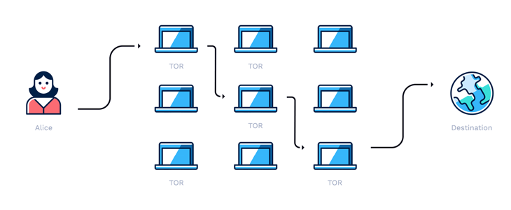
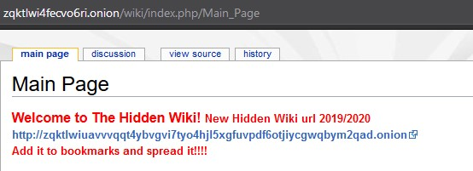
Accessing the Dark Web
Tor /I2P/ZeroNet
.onion domains/.i2p domains
Traffic through relays
Image Sources: Hotspot Shield, Tor Project, I2P Project, ZeroNet
Notes:
The Onion Router/Invisible Internet Project
16- or 56-character alphanumeric identifier strings (v2 vs v3 URLS) – v2 – RSA/DH and V3 - ECC
anonymization
Decentralized system
3-layer proxy
Publicly listed entry node, middle relay and exit node (entry nodes doesn’t know the exit node)
Original data encrypted in layers – onion analogy
IP address is hidden
Routes traffic through a series of interconnected volunteer systems called relays (about 6000 relays for Tor)

Slide 7

What’s all the Hype? Good..Bad..
Hype
Vast and mysterious part of the Internet
Place for cybercriminals only
Illegal to access the Dark Web
Reality
Few reachable onion domains
Uptime isn’t ideal
Useful for free expression in few countries
Popular sites like Facebook, NYTimes, etc.
Legal to access the Dark Web
Notes:
Dark web is not equal to criminality
Smaller than clear web if compared from availability perspective (uptime)
Tor browser circumvents surveillance – free expression in some countries
Whistleblowing or Activism, safe haven for journalists, access to literature & research
Dark web is many things but not just the vast network of criminals
Home to many other people who don’t want surveillance on them due to their nature of the work
Legal to access dark web but illegal to participate in any illicit business

Slide 8
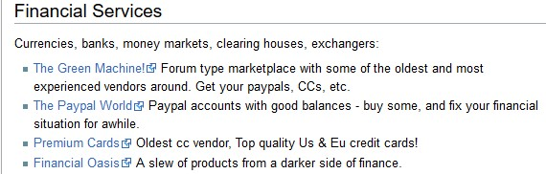
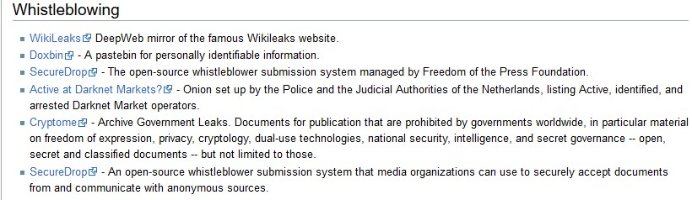
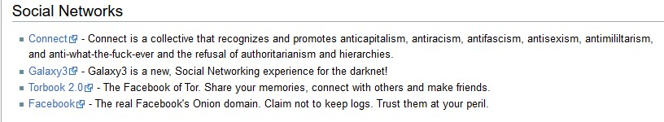
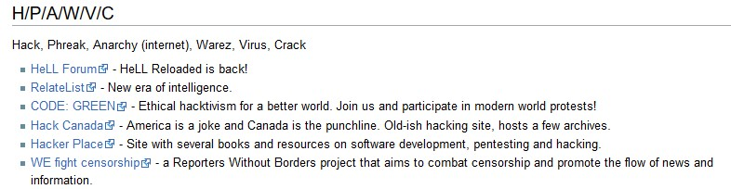
Sites Examples
Notes:
Choose your target
Threat Modelling

Slide 9
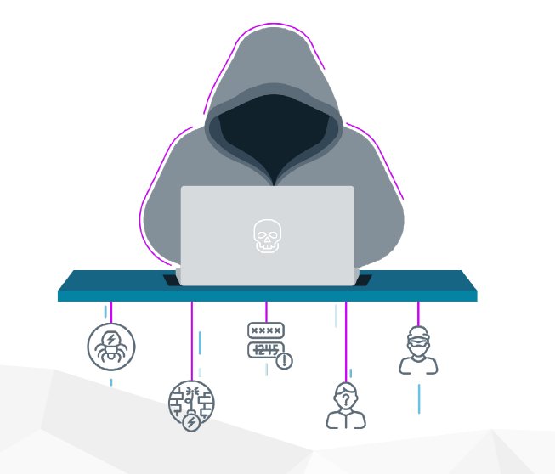
Types of Information Sold?
Personal health Records (PHI)
Social Security Numbers (SSNs)
Exposed codebases
Personally Identifiable Information (PII)
Email Password details
Financial data like credit cards, accounts
Image Source: Intsights
Notes:
Choose your target
Threat Modelling

Slide 10
Cost of products?
SSN - $2
DDoS Service - $7/hr
Rent a Hacker - $12/hr
Credit Card - $25+
FB Account- $65+
Crypto Accounts - $300+
License/Passport - $100 - $7000
Bank Details - $1000+
Exploits or 0-days - $150,000+
Critical databases - $300,000+
Source: https://www.privacyaffairs.com/dark-web-price-index-2021

Slide 11
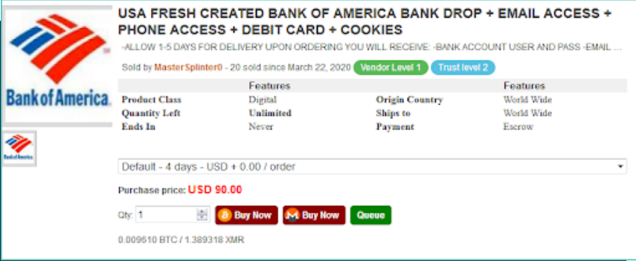
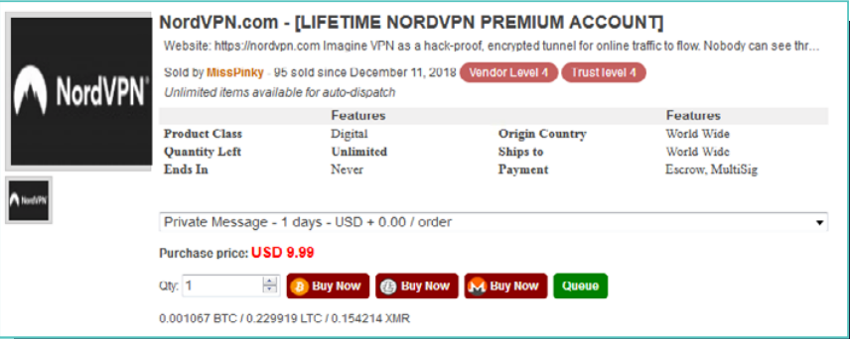
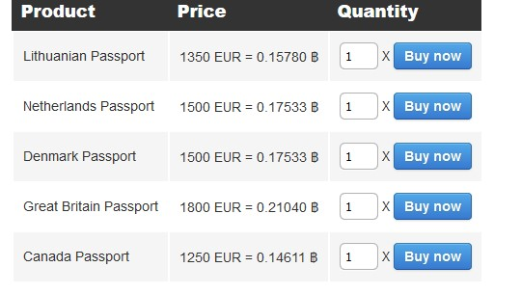
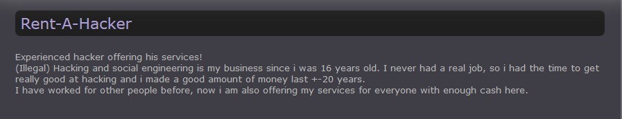
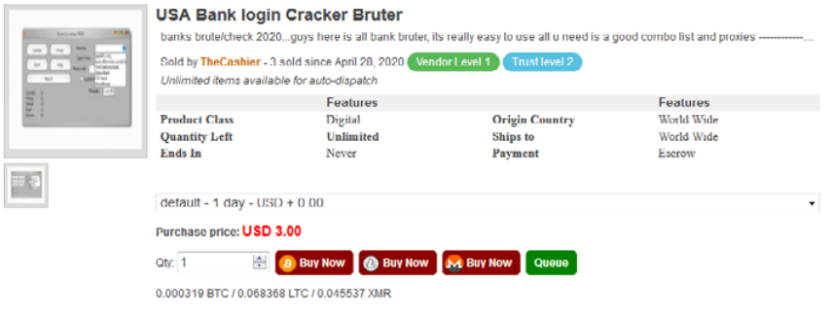
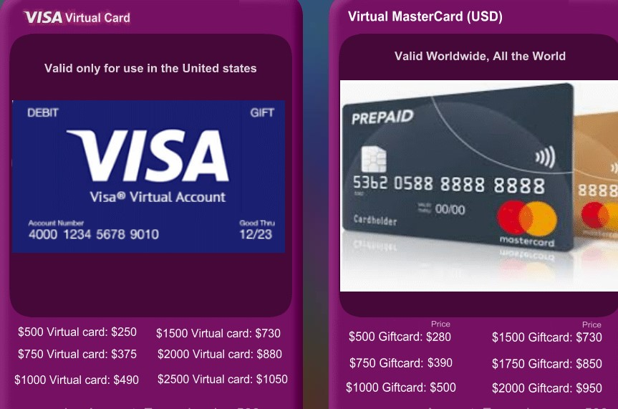
Product/Service Examples

Slide 12
2. Why focusing on the Dark Web

Slide 13

Why So Serious (Eh! Important)?
Hacker forums, darknet markets, dump shops, etc.
Criminals can learn, monetize,
trade, and communicate
Identification of compromised assets
Can potentially identify attacks in
earlier stages
Direct impacts – PII (Personal Info),
financial, EHRs (healthcare records), trade secrets
Indirect impacts – reputation, revenue loss, legal penalties
Notes:
Learn – criminals learn new methods and techniques
Monetize – monetize their skills
Trade – trade their exploits/tools, drugs, weapons
Communicate – communicate with other criminals
Can learn a lot on engaging with these communities
The intelligence from dark web isn’t available anywhere else
Identify attackers,
vulnerability prioritization
in planning and recon stages
Takes a lot of time, If done properly, it can even identify attacks in planning and recon stages

Slide 14
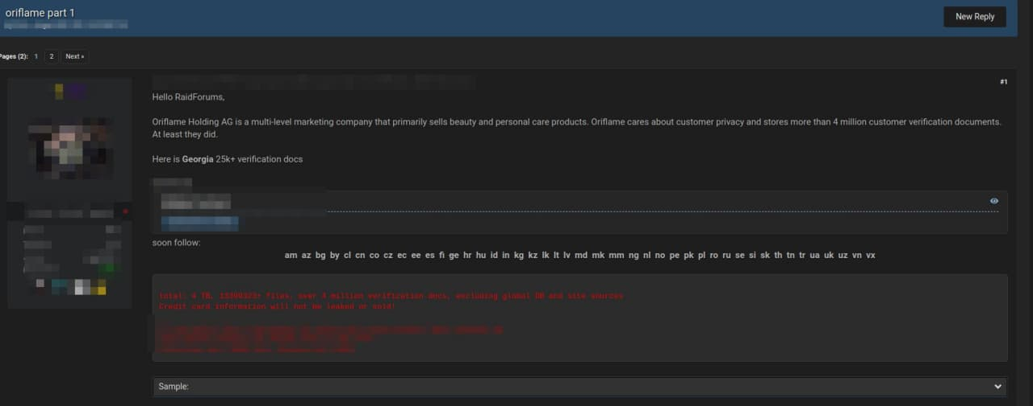
Why should you care?
Notes:
People data – personal PII

Slide 15
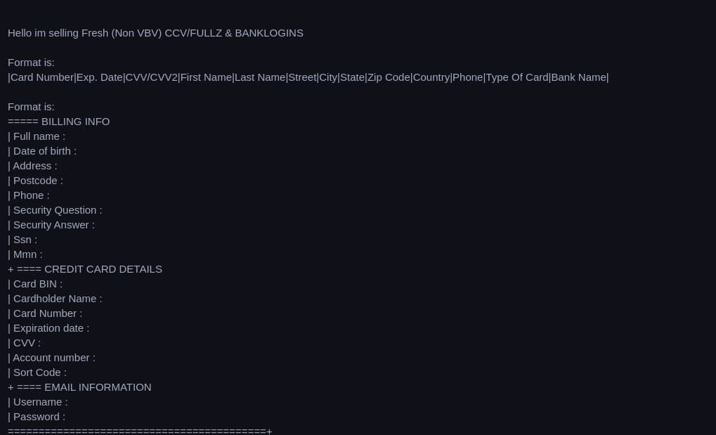
Why should you care?
Notes:
Bank data – credit cards

Slide 16
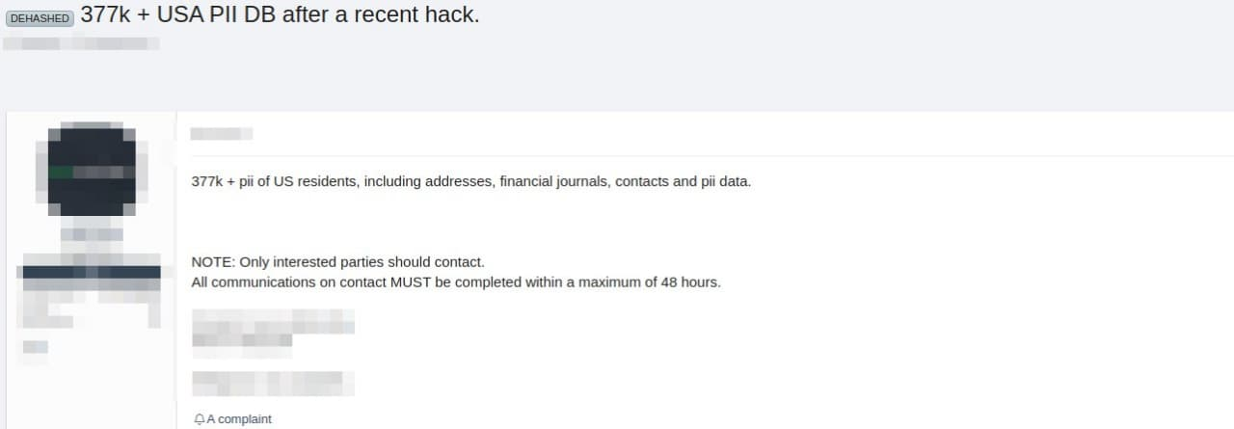
Why should you care?
Notes:
PII data

Slide 17
3. Methodology and Skills

Slide 18
What skills you need?
People Skills
Understanding people
Soft Skills
Knowledge of different languages
Research mindset
Technology Skills
Scripting (Python, Go)
Knowledge of databases (SQL, ES, Mongo)
Knowledge of VMs, Cloud instances
Notes:
Research mindset - Answering 5 basic questions – who, what, when, where, why, how
Who is it about?
What happened?
When did it happened?
Where did it happen?
Why did it happen?
How did it happen?

Slide 19
4. People Skills

Slide 20

OSINT
Open-Source Intelligence
Starter to any intelligence research
All public surface web data
Easy to find
Basic information gathering
Has good and bad parts
Information on threat actors
Image Source: ACFCS
Notes:
Process of gathering intelligence through publicly available source
The bad – theft, scams, social engineering, kidnapping, etc
The good – identify witness & criminals, monitoring terrorists, investigative journalism
Is TA well-known

Slide 21

HUMINT
Human Intelligence
Most dangerous and difficult form
Most valuable source
Infiltrating forums, markets, etc.
Become one of them
How threat actors think
Profiling actors
Can be very risky
Time consuming
Image Source: Intsights
Notes:
Process of gathering intelligence through interpersonal contact and engagement, rather than by technical processes
As attacks are human-driven, to anticipate, Identify and respond to attacks requires human skill and effort
In The Art of War, Chinese military strategist Sun Tzu wrote: “To know your Enemy, you must become your Enemy.”
Understanding the motives and tendencies behind your adversaries is a key to any type of warfare, including cyber warfare
It’s the high-tech equivalent of what an undercover FBI agent does when he or she spends months or years working to infiltrate a criminal organization.
Using HUMINT to bolster - Post Attack Investigation, New Attack Vector Discovery, etc

Slide 22
5. Technology Skills

Slide 23
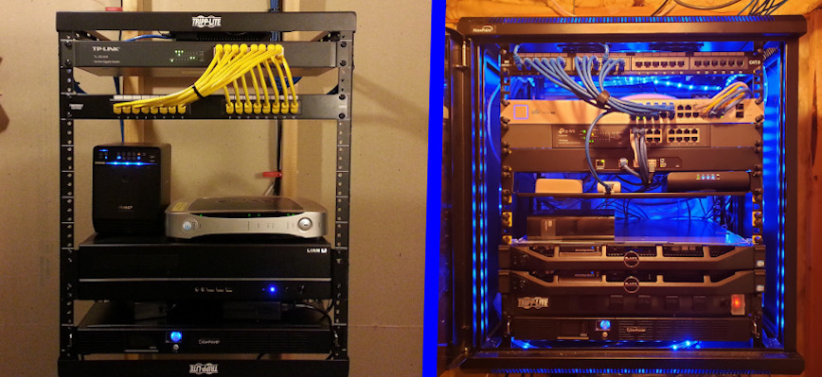
Setting up a Lab
Lab/VM
Physical or Cloud
Isolate the network
Install relevant tools
Go
Scrapy
Privoxy
Tor
ELK
Go libraries
Python libraries
Image Source: Hayden James

Slide 24
Readily Available Tools
Search Engine tools
Onion Link Collection tools
Onion Link Scan tools
Onion Link Scraping tools
All tools available at: https://github.com/apurvsinghgautam/dark-web-osint-tools
Notes:
You can start contributing to these tools

Slide 25
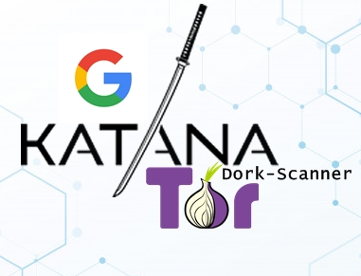



Search Engine Tools
Katana
Onionsearch
Ahmia Search Engine
Darksearch
Image Sources: Katana, OnionSearch, Ahmia, DarkSearch

Slide 26

Onionsearch
Notes:
Built in multithreading
16 search engines
Threads can be tuned

Slide 27
Onionsearch (Contd.)
Notes:
Search engine, title of the webpage, onion link

Slide 28

Onion Link Collection Tools
Hunchly
H-Indexer
Tor66
r/onions
Image Sources: Hunchly

Slide 29
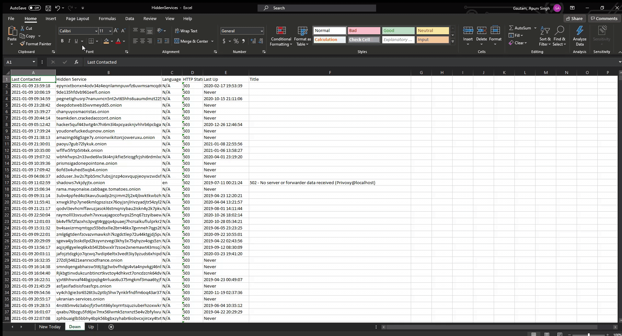
Hunchly

Slide 30

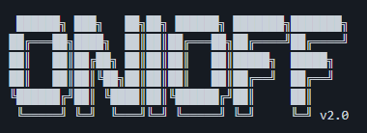
Onion Link Scan Tools
OnionScan
Onioff
Onion-nmap
Image Sources: OnionScan, Onioff

Slide 31

OnionScan
Notes:
Scan for visible pages
Scan for vulnerabilities
Scan for services
Released a correlation lab -> to check correlations between different onion sites

Slide 32
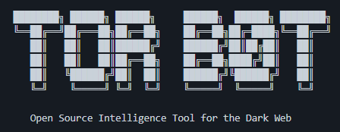

Onion Link Scraping Tools
TorBot
TorCrawl
OnionIngestor
Image Sources: TorBot, OnionIngestor

Slide 33
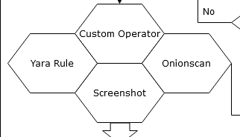
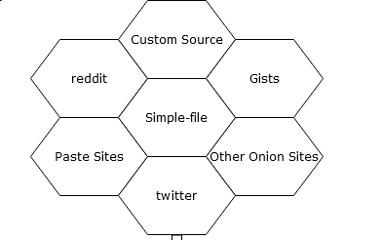
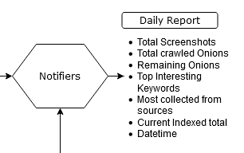
OnionIngestor
Notes:
Sources
Operators
Stored in Elasticsearch

Slide 34
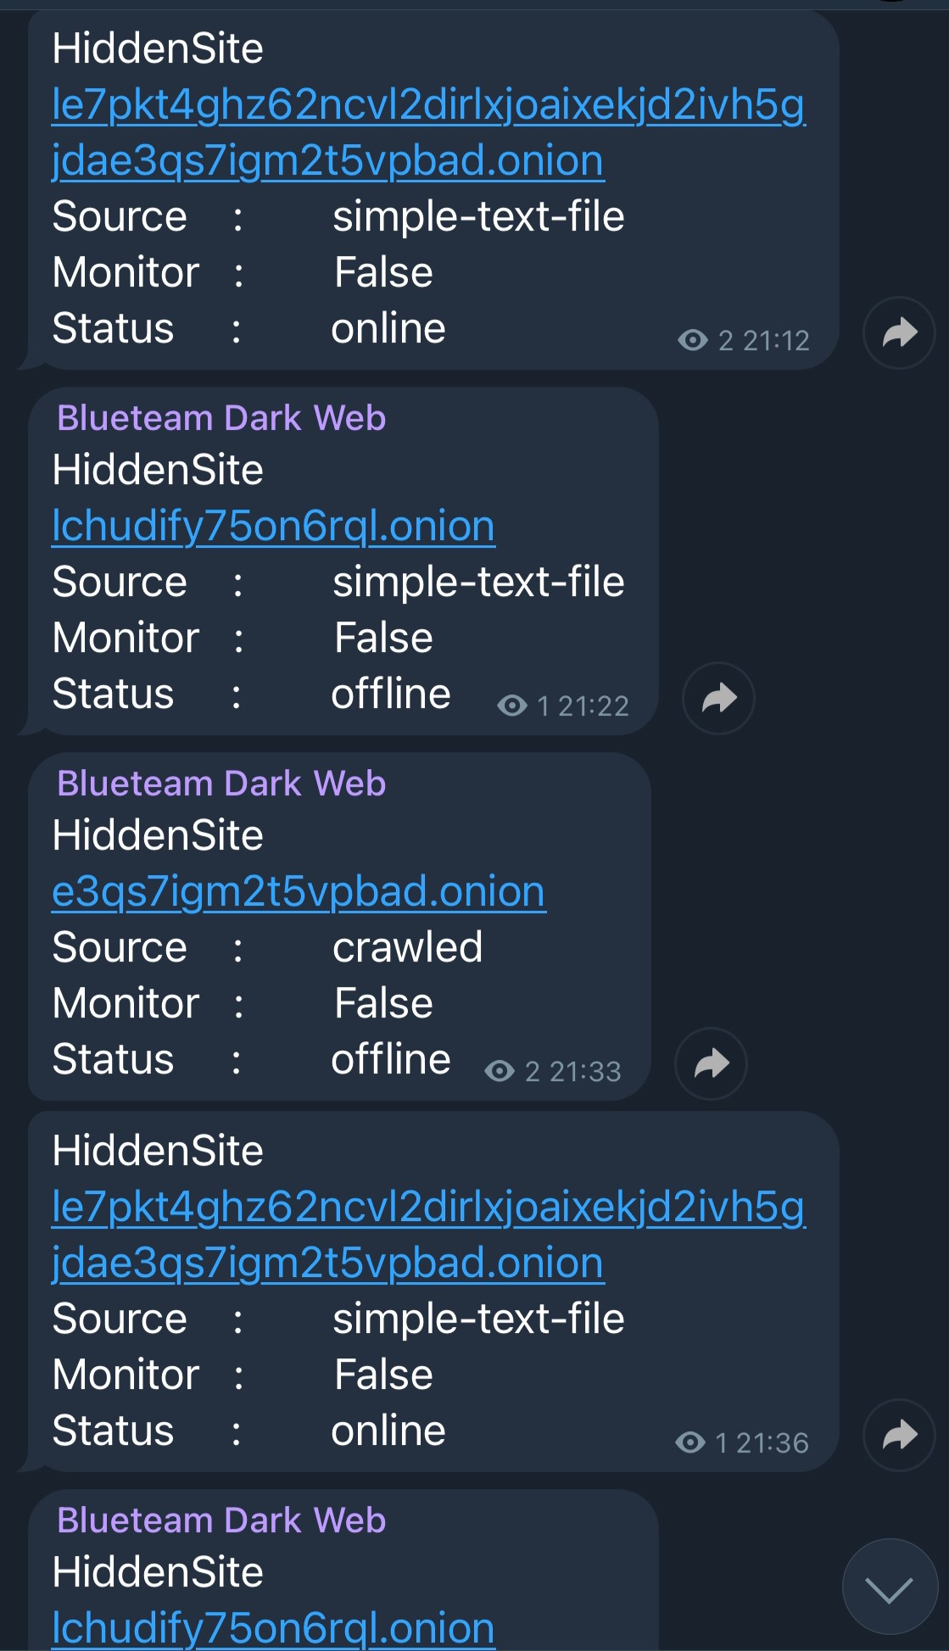
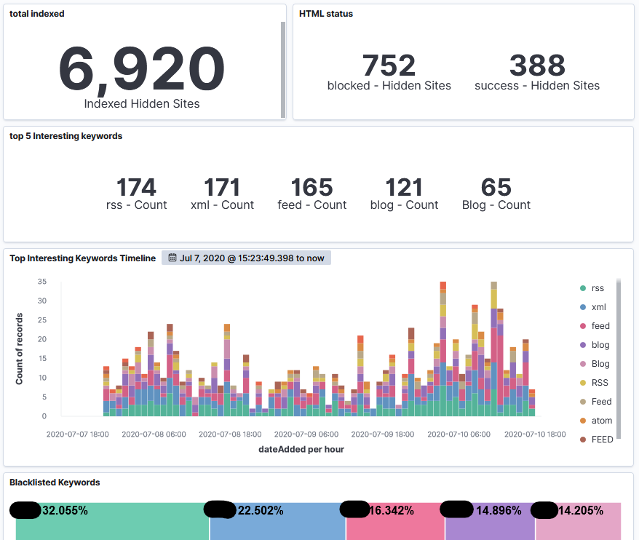
OnionIngestor (Contd.)

Slide 35
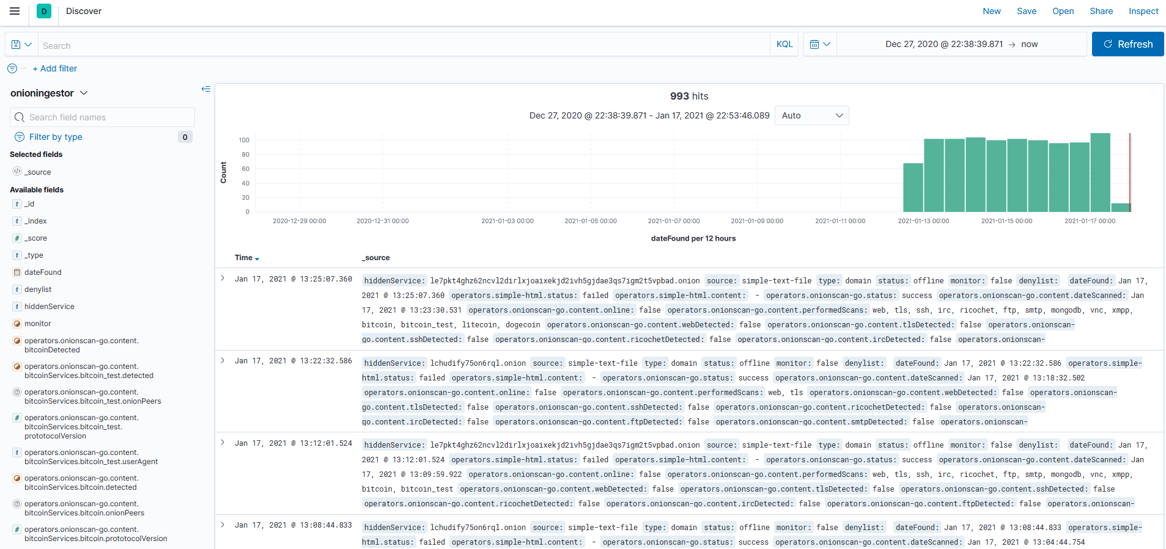
OnionIngestor (Contd.)

Slide 36



Create your own tools
Scrapy
Tor
OnionScan
Privoxy
Elastic
and many more…
Image Sources: Tor Project, OnionScan, Scrapy, Privoxy, Redis
Notes:
Scrapy - web-crawling framework - multithreading capability
OnionScan - open source tool for investigating the Dark Web, scanning different onion sites for vulnerabilities, correlations between sites, etc
Different ways of using socks proxy – tsocks, polipo, Privoxy, etc.
Privoxy – web proxy – scrapy cannot use socks proxy so route through Privoxy (tor with socks – layer of protection) - to hide using tor from your ISP
Use VPN + SOCKS for extra protection - hide your activity and get real safe access - can’t trust entry and exit nodesTorch
Onion Wiki
Search engines like Kilos, Recon

Slide 37
6. OpSec? What’s that?

Slide 38
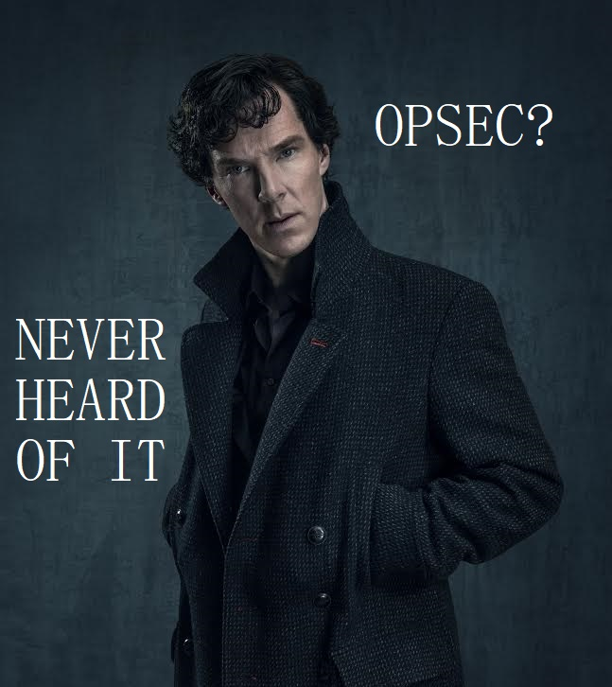
What is OpSec?
Actions taken to ensure that information leakage doesn’t compromise you or your operations
Derived from US military – Operational Security
PII – Personally Identifiable Information
Not just a process – a mindset
OpSec is Hard
Notes:
the practice of hiding yourself online by disassociating your online persona with your real self
We are all humans
We desire to be seen knowledgeable and to impress others
Leads to gossip, brag, and overshare
PII – personal information that can identify you – full name, SSN, driver’s license, bank account, email, passport number, etc.

Slide 39

Maintaining OpSec in your lifestyle
Use VM/Lab or an isolated system
Use Tor over SOCKS or VPN
Change Time zones
Never talk about your work
Maintain different persona
Take extensive notes
Use password manager
Notes:
You have to do opsec from the beginning/proactivly because you can't do opsec "retroactively"
Never store any personal information on the VM or the system you are accessing dark web from
Clean/Wipe all the data before leaving the system and start fresh the other day
Watch what you say to whom and where
Think before you post
Have different persona on different sites, don’t mix it., Have a back story for each personas
Take notes so you don’t mess up the personas
It’s a 24x7 thing to do and not during your job duration
You can’t work 9-5 as that would be a tip off that you are not a threat actor.
Develop appropriate language skills and slang skills

Slide 40
7. Case Study

Slide 41
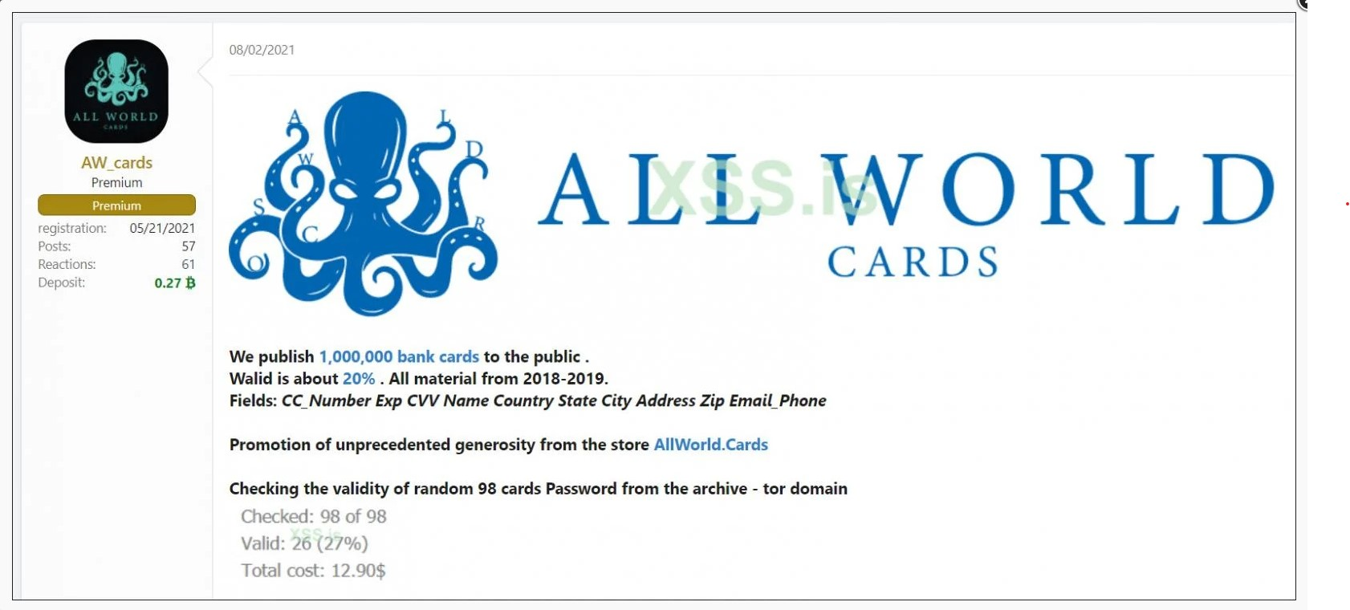
All World Cards 1M Credit Cards
Notes:
All World Cards is a carding website
Released 1M credit cards for free – 20% still valid (200k)

Slide 42
Type of Data Leaked
CC number
CVV
Name
Country
Address
Email/Phone

Slide 43
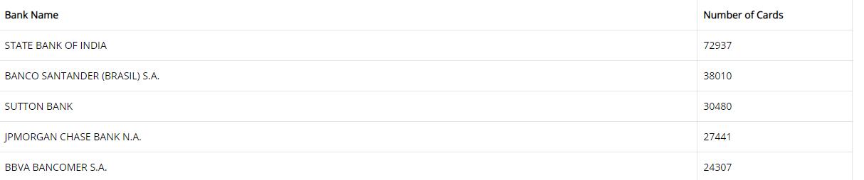
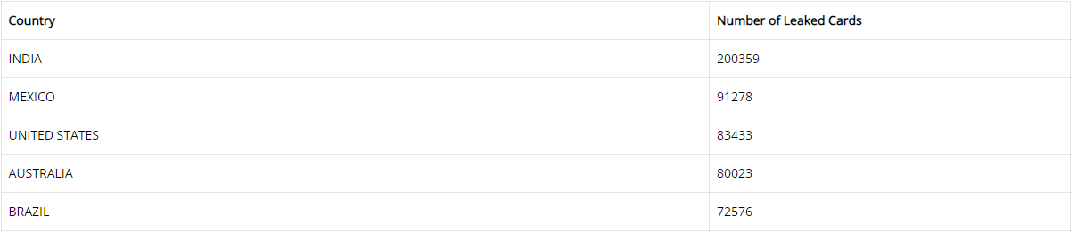
Affected Banks/Countries
Source: https://blog.cyble.com/2021/08/08/one-million-credit-cards-leaked-in-a-cybercrime-forum-for-free/
Notes:
500+ banks affected

Slide 44
8. Conclusion

Slide 45
What we discussed so far?
Types of web
Misconceptions of Dark web
Why Dark web is important to monitor
Skills needed to perform Dark Web monitoring
OSINT, HUMINT
OSINT tools
Methods to create your own scripts

Slide 46
I don’t know how to conclude but..
Dark Web monitoring is hard but worth the effort
Keep OpSec in mind
Look at more than one resource
Takes a lot of resources and team effort
It can be fun if you enjoy research and investigations
Notes:
You don’t get the intelligence from anywhere else
Look at more forums

Slide 47
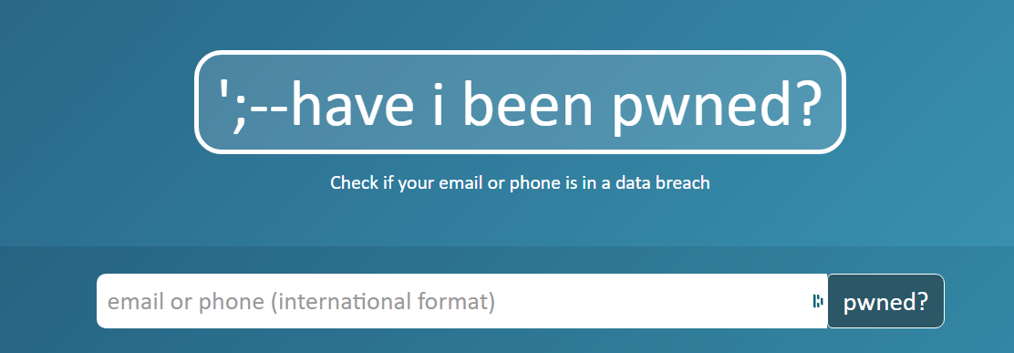
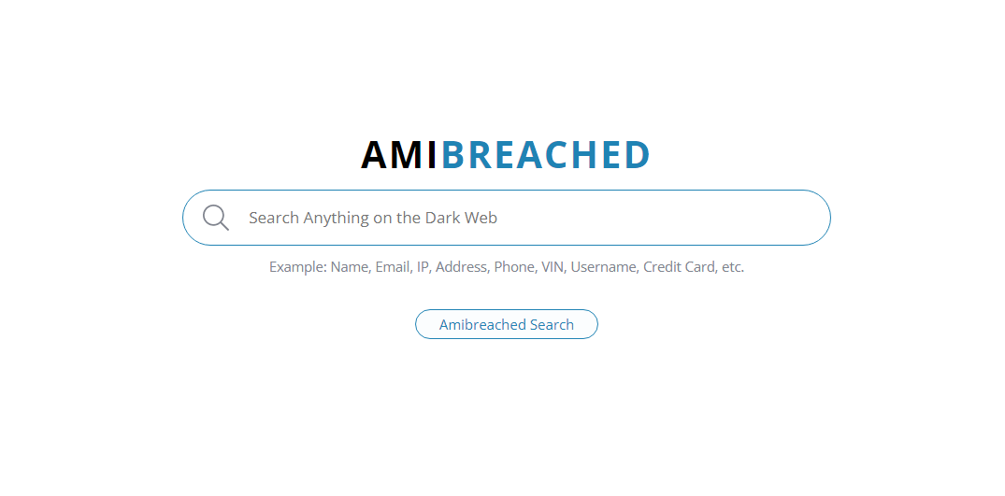
How to protect yourself
Search on surface web to identify the information available
Utilize services like AmIBreached or HaveIBeenPwned to see how much data is exposed
Source: https://haveibeenpwned.com/, https://www.amibreached.com/
Notes:
Change passwords
Change credentials
Use password managers
Use MFA
Lookout for social engineering scams

Slide 48
Resources
Read White papers & blogs from different security organizations
Follow people on LinkedIn and Twitter
Follow hashtags - #darkweb, #threatintelligence
Search Terms – darkweb, tor, deepweb, cybercrime forums
OSINT Framework - https://osintframework.com/
OSINT Combine Dark Web Searching - https://www.osintcombine.com/post/dark-web-searching
Notes:
Add blogs in the search terms
Want to start in this – look for jobs for vendors that do this specifically

Slide 49
Resources (Contd.)
Jake Creps Blog - https://jakecreps.com/2019/05/16/osint-tools-for-the-dark-web/
SANS Cyber Defense Forum - Automating Threat Hunting on the Dark Web and other nitty-gritty things talk by Apurv Singh Gautam
DEFCON Recon Village - Ambly the Smart Darknet Spider talk by Cytisus Eurydice (@levitannin)
Notes:
Add blogs in the search terms

Slide 50

Thanks!
Any questions?
You can contact me at:
Twitter: @ASG_Sc0rpi0n
LinkedIn: /in/apurvsinghgautam

